Slide 1
87-91 Newman Street
London, W1T 3EY
Key Points
Stiff + Trevillion Architects will soon begin remodeling the reception and common parts, giving this building an even more dynamic sense of arrival.
Exposed painted concrete ceiling.
Staffed reception & 24 hour security.
Two passenger lifts.
Bike storage (via Berners Place).
Property type | Offices
Tenure | To Let
Floor / Size | 3rd 4,219 sq ft – Available 2nd 7,965 sq ft - LET Total 12,184 sq ft
Guiding Rent | Guiding mid £70's per sq ft exc.

Slide 2
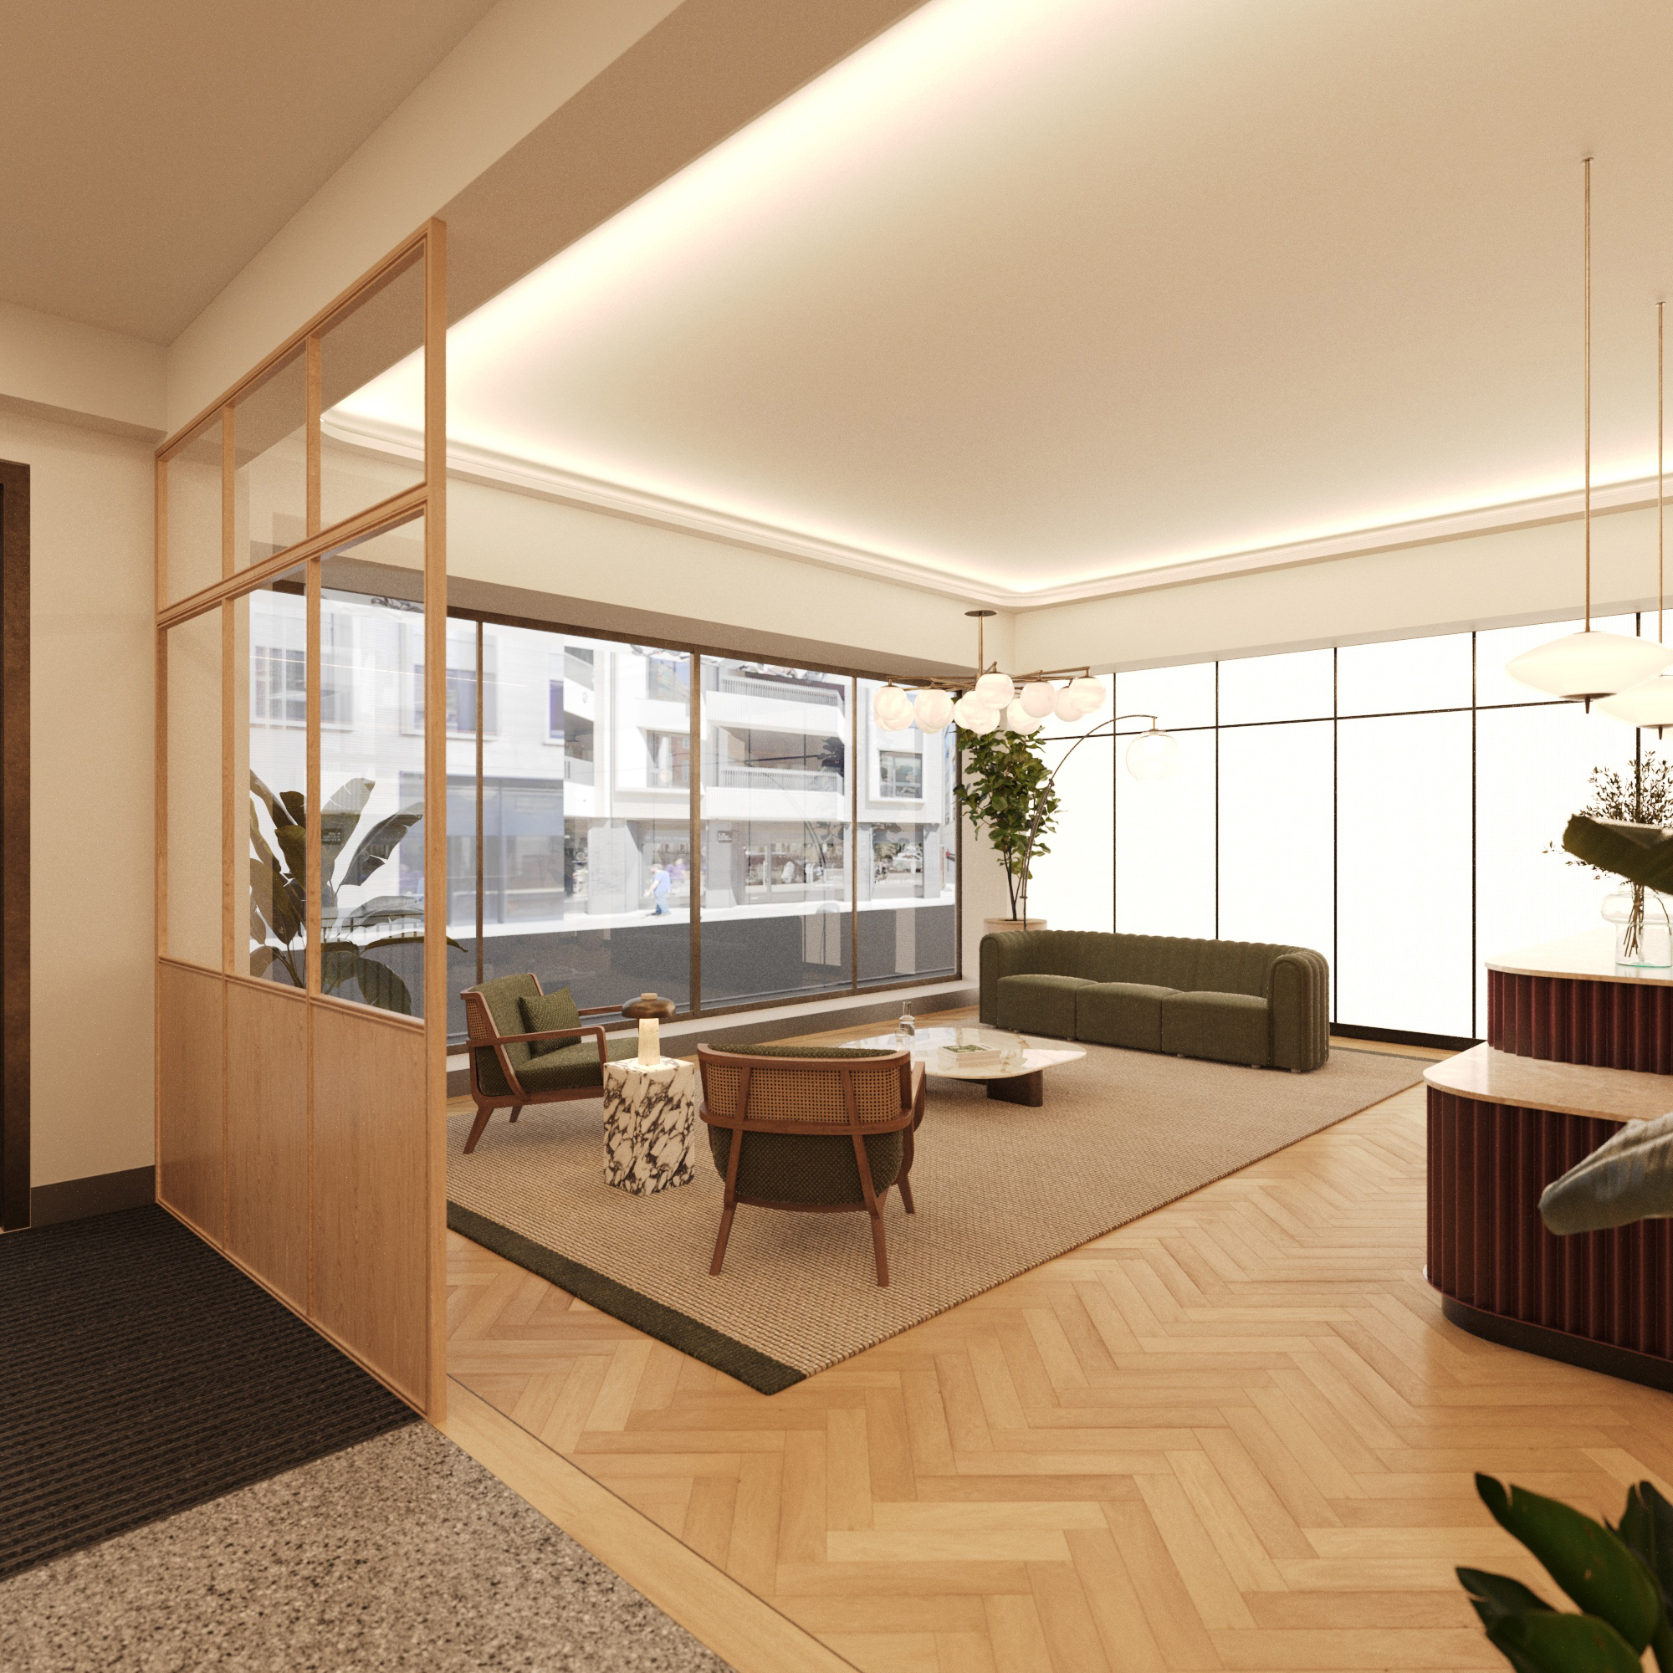
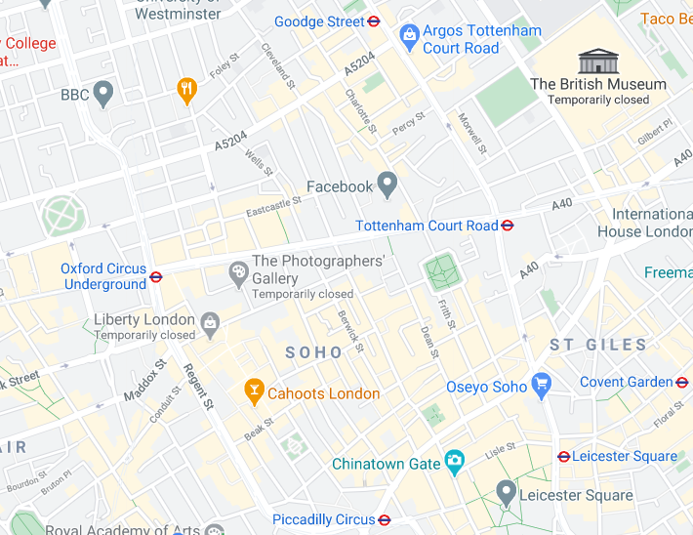
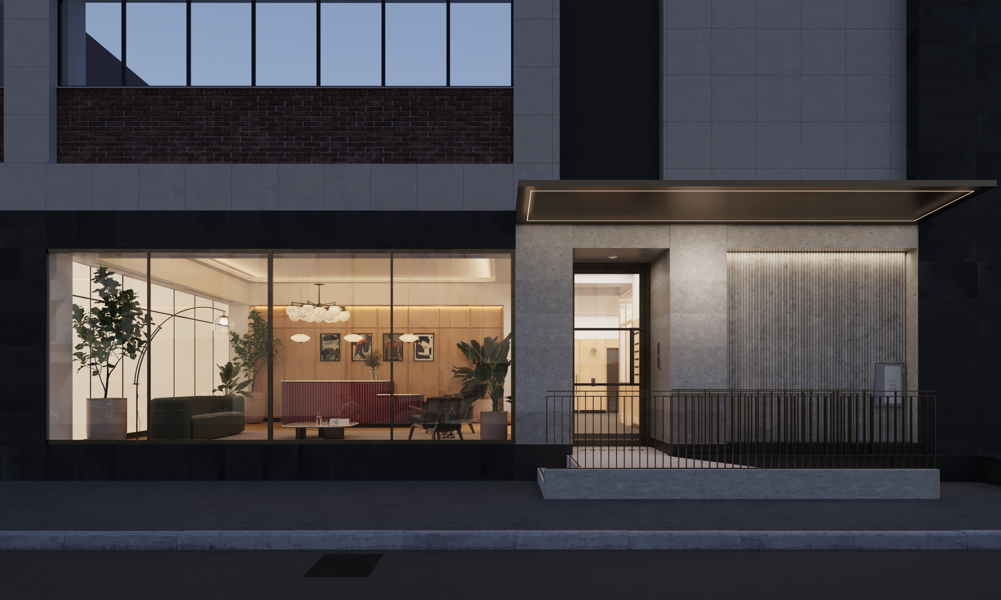
87-91 Newman Street
London, W1T 3EY
Location
The building, which was refurbished in 2002, is situated on the west side of Newman Street, close to its junction with Oxford Street and over looks the Facebook campus. The area is well served some of the most exciting and lively restaurants and bars in London.
Tottenham Court Road (Northern, Central Elizabeth lines) and Oxford Circus (Victoria, Central and Bakerloo lines) underground stations are both within easy walking distance
Description
The building provides a large, modern staffed reception with two automatic passenger lifts.
The 2nd floor provides bright office accommodation which is under refurbishment to a new Cat A spec. The floor plate includes a central lightwell which adds to the natural light throughout.
3rd floor will be available from Q1 2025– this will be offered in a fully fitted (CAT A+) condition
Accommodation
Terms
A new lease is available directly from the Landlord for a term by arrangement, outside the 54 Act.
Please note, there is a block date in this building in January 2031
Energy Performance Rating
D
Business Rates
Estimated at £28.00 per sq ft
Tenants are advised to make their own enquiries in this regard.
Service Charge
Approx. £10.00 per sq ft
Viewing & Further Information
Harriet James
020 7758 3287
07586300172
harrietjames@ashwell.london
Ash Sharma
020 7758 3285
07721 001 751
ash@ashwell.london
or visit: @ashwell.london
Joint Agent
Monmouth Dean
January 2025
Demise | Sq Ft
3rd Floor – Available | 4,219 sq ft
2nd floor - LET | 7,965 sq ft
Total | 12,184 sq ft

