Slide 1
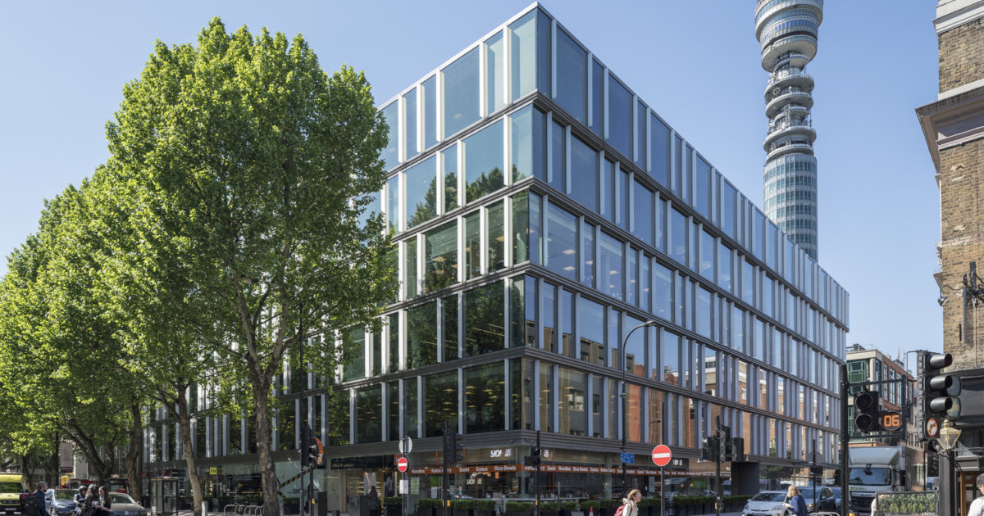
90 Whitfield Street, W1
CAT A – Part 5th floor- 6,458 sq ft
Key Points
Property type | Offices
Tenure | New Lease
Size | 6,458 sq ft /599.96 sq m
Rent | Quoting £89.50 per sq ft exc
Impressive 2.8m ceiling height to underside of raft
New four pipe fan coil air-conditioning in a raft system
Upgraded 5th floor common parts
Newly refurbished reception
Stunning full-height atrium
New end-of-journey facilities at ground floor
- 54 x cycle bays
- Shower facilities
24-hour building security
EPC Rating ‘C
The building is a 1-minute walk to DL/78 on Charlotte Street, a private and complimentary Lounge for DL/ Members.

Slide 2
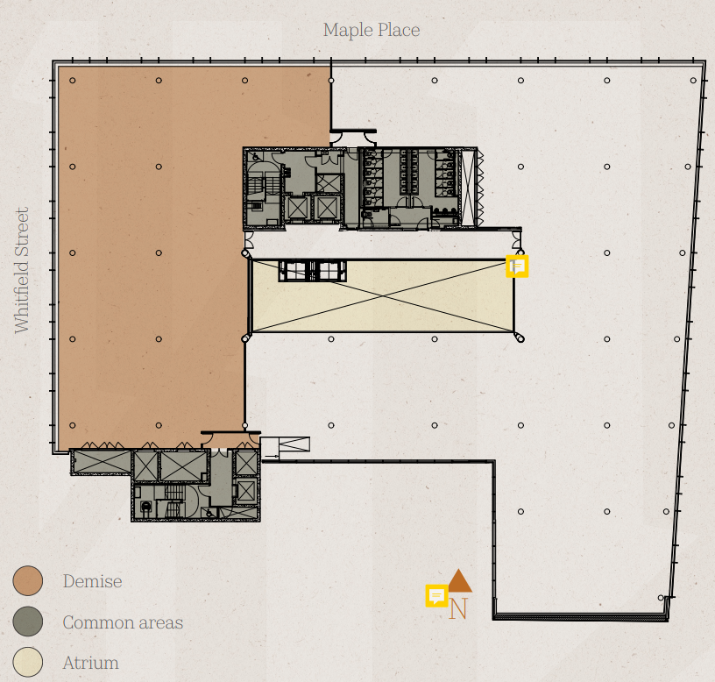
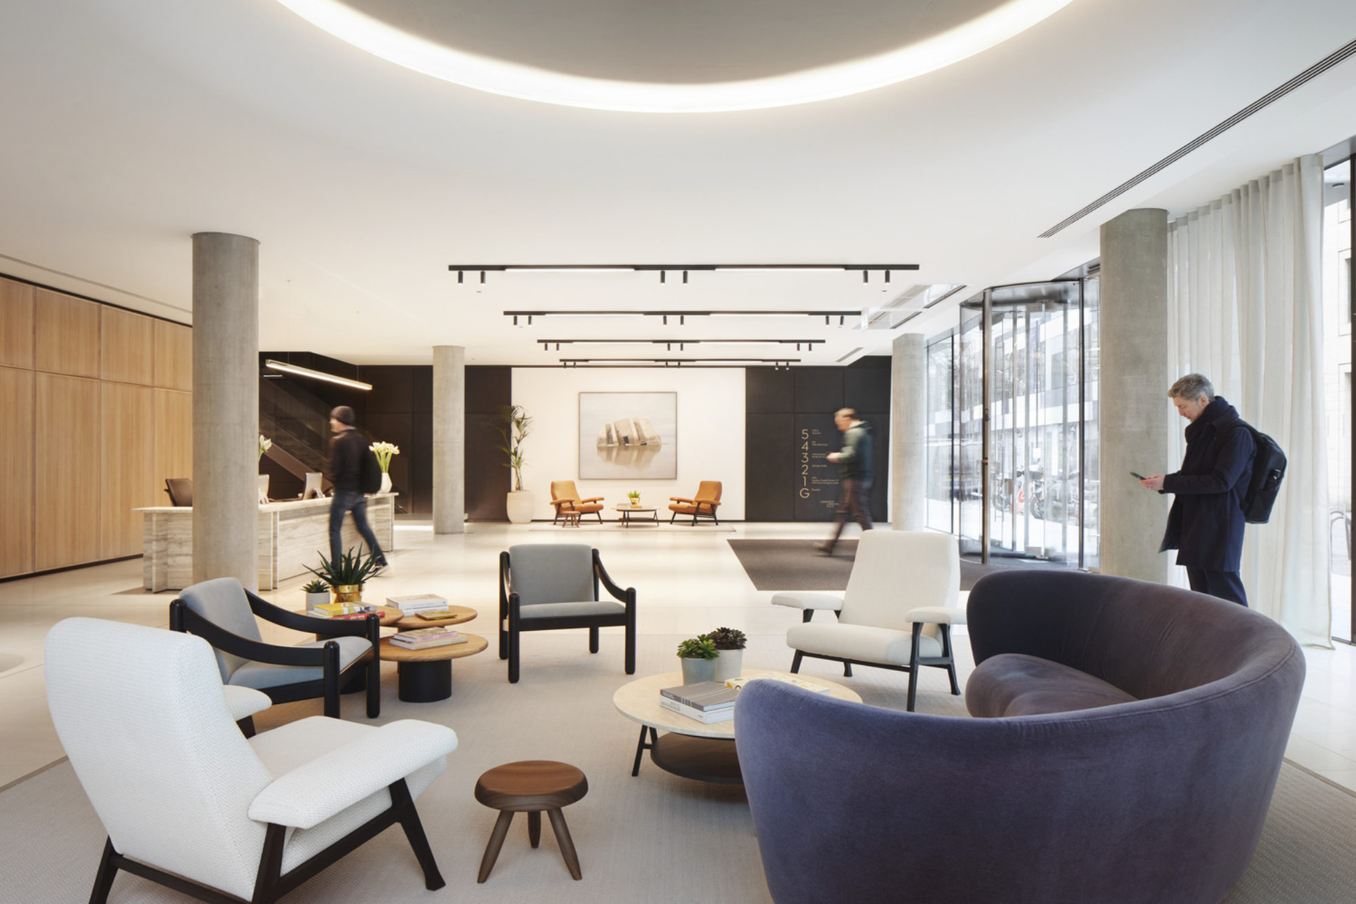
90 Whitfield Street, W1
CAT A – Part 5th floor- 6,458 sq ft
Location
A Fitzrovia base offers businesses convenient Underground and bus links to all London destinations and beyond.
Goodge Street and Warren Street Underground stations are just a 5-minute walk away, connecting you effortlessly to the Northern and Victoria lines. A quick walk to Tottenham Court Road station brings you to the Elizabeth line station, London’s high-speed east/west connection.
Description
90 Whitfield Street sits at the corner of Maple Street and Whitfield Street, and the distinctive glazed elevations create a sense of movement across the façade, catching the eye of passers-by.
The large staffed reception on the ground floor is 3,000 sq ft, which has just undergone a recent refurbishment by Stiff + Trevillion to provide a contemporary club style finish in keeping with the location and the building.
The part 5th floor is on the north-west corner of Whitfield Street and currently unfitted (CAT A).
The floor offers fantastic natural daylight and wonderful views.
Terms
The property is available on a new lease directly from the Landlord
Rent:
Quoting £89.50 sq ft exc
CGI of the part 5th floor
Energy Performance Rating
C
Business Rates
Tenants are advised to make their own enquiries.
Service Charge
TBC
Viewing & Further Information
Ash Sharma
07721 001751
ash@ashwell.london
Harriet James
07586 300172
harrietjames@ashwell.london
or visit: Ashwell.London
Joint agents : JLL
July 2024

